Slide 1



Machine Downtime Analysis

Slide 2




Project Leadership
Sharat Manikonda
Director at Innodatatics and Sponsor
linkedin.com/in/sharat-chandra
Bharani Kr. Depuru
Director at Innodatatics and Sponsor
linkedin.com/in/bharanikumardepuru
Mihir Jain
Data Scientist
linkedin.com/in/mihirjain0405
Vaibhav Tiwari
Data Analyst
linkedin.com/in/vaibhav-tiwari-a3b16b217

Slide 3
Contents
Business Problem
Business Overview and Scope
Data Dictionary
Exploratory Data Analysis
Visualization
Notes:
Change

Slide 4
Business Problem
In our industrial operation, machine downtime is impeding productivity, incurring unnecessary costs, and impacting our bottom line. The objective of this project is to analyze historical downtime data and identify causative factors. Our goal is to reduce unplanned downtime, and improve profitability.
Business Objective : Minimize Machine Downtime
Business Constraint : Minimize Cost

Slide 5
Project Overview and Scope
This project will focus on analyzing historical machine downtime data to reduce unplanned downtime and improve equipment efficiency. The scope includes data analysis, and recommendations for optimizing maintenance and operational processes. The project does not encompass physical equipment modifications or replacement.
Milestone | Deliverable
Identifying Constraints and design the project architecture, explore various public forums to collect relevant data, Data Preparation. | Deliverable 1.1—Identifying Constraints and design the project architecture. Deliverable 1.2—Explore various public forums to collect relevant data. Deliverable 1.3— Data Preparation
EDA and Descriptive Analytics | Deliverable 2.1— EDA and Descriptive Analytics Deliverable 2.2— Insights documentation
Show case and review, Final Presentation and documentation, Handover and KT. | Deliverable3.1 – show case and review. Deliverable3.2 – Final Presentation and documentation Deliverable3.3 – Handover and KT

Slide 6
Data Dictionary
1. Date: The date when the data was recorded.
2. Machine_ID: A unique identifier for the machine or equipment.
3. Assembly_Line_No: The number of the assembly line where the machine is located.
4. Hydraulic_Pressure(bar): The hydraulic pressure in bars, a measure of hydraulic system performance.
5. Coolant_Pressure(bar): The coolant pressure in bars, a measure of the coolant system performance.
6. Air_System_Pressure(bar): The air system pressure in bars, a measure of the air system performance.
7. Coolant_Temperature: The temperature of the coolant.
8. Hydraulic_Oil_Temperature(°C): The temperature of the hydraulic oil in degrees Celsius.
9. Spindle_Bearing_Temperature(°C): The temperature of the spindle bearings in degrees Celsius.
10. Spindle_Vibration(µm): The vibration level of the spindle in micrometers.
11. Tool_Vibration(µm): The vibration level of the tool in micrometers.
12. Spindle_Speed(RPM): The speed of the spindle in revolutions per minute (RPM).
13. Voltage(volts): The voltage level.
14. Torque(Nm): The torque applied, measured in Newton-meters (Nm).
15. Cutting(kN): The cutting force applied, measured in kilonewtons (kN).
16. Downtime: An indicator representing machine downtime.

Slide 7
Exploratory Data Analysis [EDA]
> First Moment Decision : Measures of central tendency (i.e. Mean, Median, Mode).
> Second Moment Decision : Measures of dispersion (i.e. Variance, Standard Deviation, Range).
> Third Moment Decision : Skewness
> Fourth Moment Decision : Kurtosis
Notes:
EDA is used for seeing what the data can tell us before the modeling task.
Change

Slide 8
Data Preprocessing
Duplicates handling : No duplicate values were found in the dataset.
Outlier Treatment : Removed / Trimmed values > 3Sigma
Handling Missing Values : Filled missing values with respective column means
Dummy Variable Creations : One hot encoded the machine IDs.
Notes:
Keep observations

Slide 9
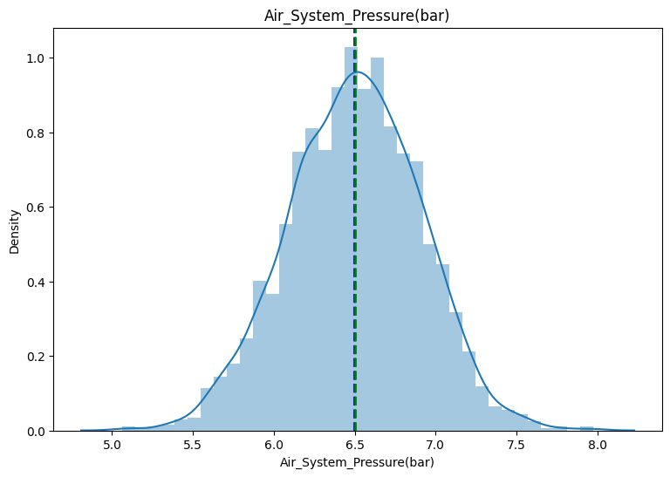
Data Visualization
Univariate Analysis
Notes:
Add graphical

Slide 10
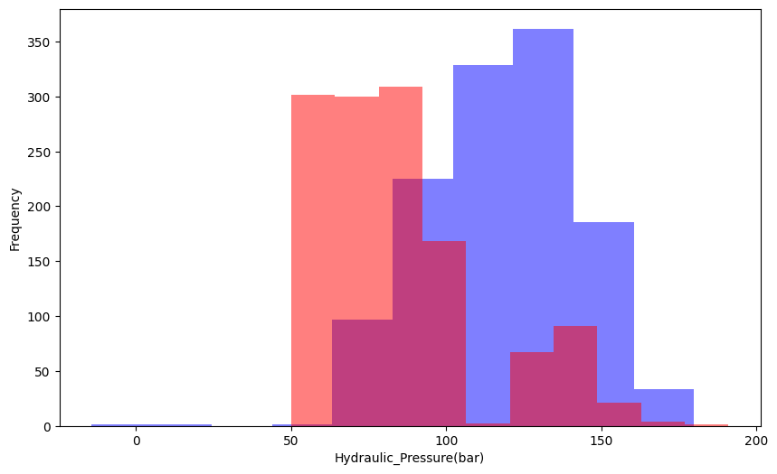
Data Visualization
Bivariate Analysis
Notes:
Add graphical

Slide 11
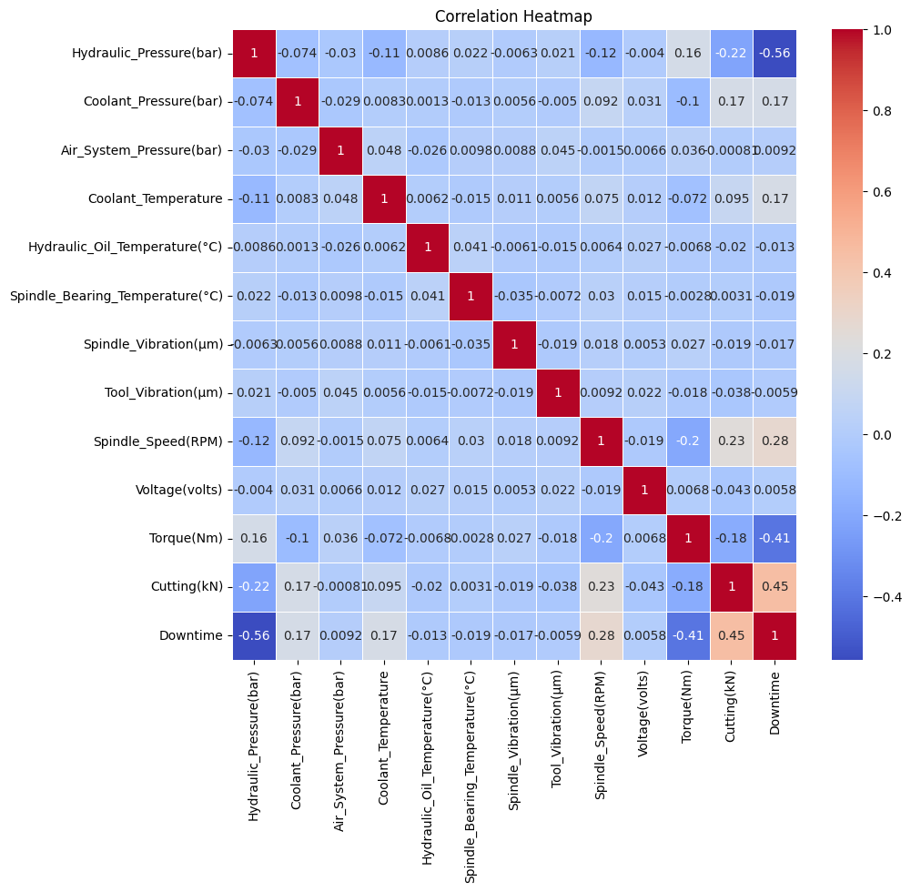
Data Visualization
Multivariate Analysis
Notes:
Add graphical

Slide 12


